Slide 1

Project 2 - DucklingInsurance
By Khalon Rodney
Notes:
Hello and good afternoon everyone. My name is Khalon Rodney and today I will be showcasing my project, DucklingInsurance.

Slide 2
Project Description – DucklingInsurance
A Full-stack 3-tier web app for buying and managing insurance online
Customers get quotes, buy policies and file claims
Admins run the back office: customers, claims, payments and policy catalog
Notes:
My project, DucklingInsurance is a full-stack insurance platform I built end to end: SQL Server database, the ASP.NET Core API, and the Angular front end, all deployed live on Azure. The idea and goal for this project was to model how a real insurer works. A customer can browse eight products, such as auto, home, health, and life. Each product has coverage levels, like Liability Only, Full Coverage, and Premium, and the price is calculated from the coverage amount, the level, and the customer’s age. They can also get quotes, which are saved for 30 days until expiration. Customers are able to buy straight from that quote at the price shown to them and pay either monthly or yearly. Customers are also able to file claims, change coverage or cancel their policy.
Admins are able to see every customer who enrolled at DucklingInsurance. They’re able to edit or deactivate customer accounts, approve or reject claims, they could also see all payments and create new insurance policies.

Slide 3
Approach
Design the DB: Tables, relationships and rules
Stored Procedures: All data and business logic rules are in SQL Server
API layer: ASP.NET Core: Controller->Repository->Stored Procedures
Angular frontend: Screens, forms and role-based navigation
Azure: Deployment
Notes:
My approach for this project was DB-first. Before writing any API or screen, I designed the tables and the relationships between them: customers, policies, coverage levels, payments, claims and quotes. Then I implemented the stored procedures for business rules like calculations, blocking cancellations under certain conditions, etc. in SQL. After that I moved on to the API, which follows this flow: a controller receives the request, a repository calls the stored procedure, and the result comes back as a DTO. The controllers stay thin, and each layer has one job, I ensured all endpoints worked by testing with Swagger. After the API was finished, then came the Angular frontend with the screens, forms and navigation, with different views for customers and admins. After everything was completed I then deployed the project to Azure.

Slide 4
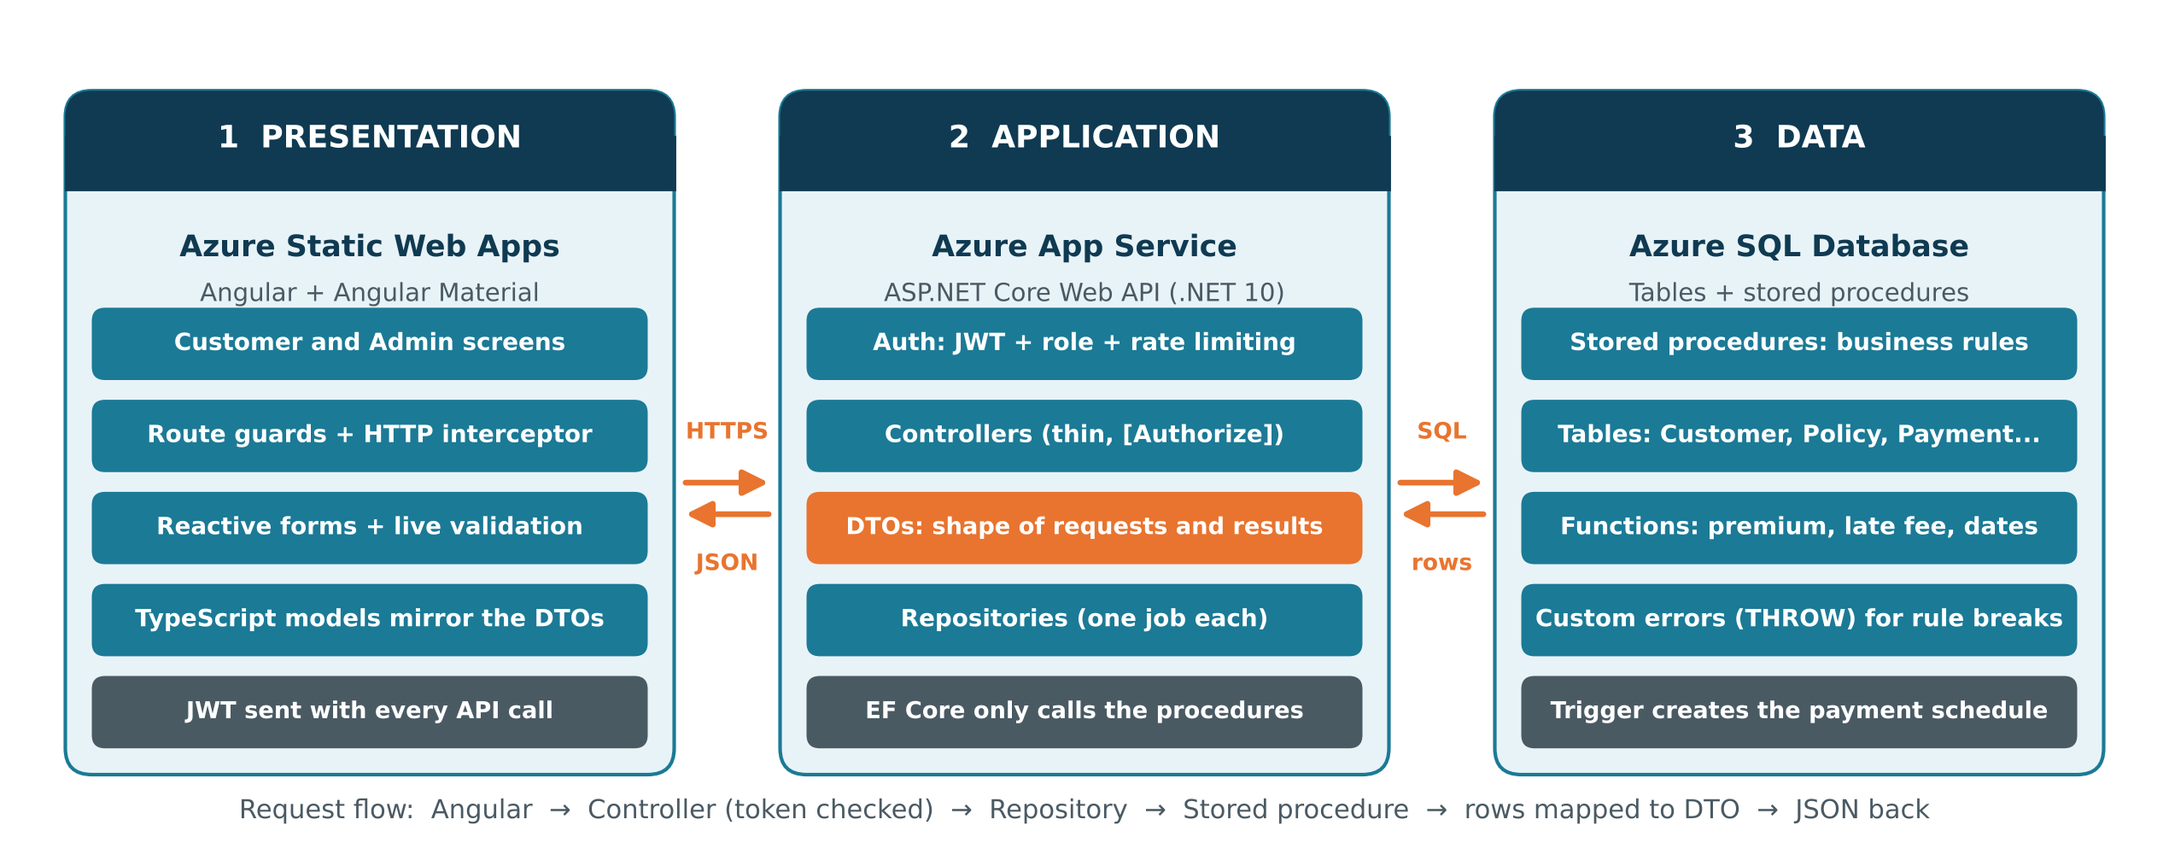
Project Architecture
Notes:
Here is the project architecture.
On the left is the presentation tier: the Angular app, hosted on Azure Static Web Apps. It handles the screens and forms, and it uses route guards to send customers and admins to the right pages. It never talks to the database directly, only communicating with the API.
In the middle is the application tier, an ASP.NET Core Web API on Azure App Service. Every request comes in over HTTPS with a JWT token. The API checks the token and the user’s role before doing anything. Controllers stay thin, repositories talk to the database, and EF Core is only used to call stored procedures.
On the right is the data tier, Azure SQL. It holds the tables, the stored procedures with the business rules, and a few functions, like premium calculation and late fees. A trigger builds the payment schedule when a policy is bought.
On the bottom is the request flow: which flows left to right and the response comes back. A button click in Angular becomes an API call. The API checks the token, the repository runs a stored procedure, and the data comes back as JSON.

Slide 5
Tools/Technologies
Frontend - Angular (standalone components, signals), Angular Material, TypeScript, RxJS
Backend - ASP.NET Core Web API (.NET 10), C#, Entity Framework Core (for calling procedures only), JWT authentication
Database – SQL Server, T-SQL stored procedures, functions and triggers, SSMS or Azure Data Studio to manage it
Azure - Azure SQL, Static Web Apps, Azure App Service, Azure CLI and SWA CLI for deployment, Git/GitHub
Notes:
Here are the technologies I used to build it, excluding the IDE which was VSCode and Development Testing Tool which was Swagger.
n the front end it’s Angular with Angular Material for the components, such as tables, dialogs and forms. I used the newer Angular style: standalone components, signals for state, and reactive forms with validation, including a live password-rules checklist.
The back end is an ASP.NET Core Web API on .NET 10, written in C#. Authentication uses JWT tokens that carry the user’s role, and the roles are enforced on the server. Entity Framework Core is in the project, but only as a way to call my stored procedures.
The database is SQL Server. A lot of the logic lives here: stored procedures for the business rules, functions for things like premium calculation and late fees, and a trigger that builds the payment schedule.
For hosting, the Angular app is on Azure Static Web Apps, and the API is on Azure App Service, and the Database is on Azure SQL Server. I deployed with the Azure CLI and the Static Web Apps CLI.

Slide 6

Security Features
JWT login, with the role stored in token
Rules are enforced in SQL Server
  Overdue payments block coverage changes and cancellation
  Coverage limited to range’s depending on chosen package
  Quotes expire after 30 days and can only be used once
Hashed Passwords
Admin must re-enter passwords to confirm sensitive actions
Login and sensitive actions are rate limited
Admin reset password issues one-time password to customer
Notes:
For security, login returns a JWT token that includes the user’s role. The important point is that the API checks that role on every request. Hiding an admin button in Angular isn’t protection, because someone could still call the endpoint directly. So the admin endpoints are locked to the admin role on the server.
Passwords are hashed, and no endpoint ever returns them. For the most sensitive admin actions, such as editing a customer, deactivating an account, or creating a product, the admin has to re-enter their password. Login and those actions are also rate limited, to slow down guessing.
When an admin resets a customer’s password, the system generates a random temporary password that’s shown once. When the customer logs in, they’re taken to a full-screen page where they must choose a new password, and the API blocks everything else until they do.
The business rules are enforced in the database, in the stored procedures. For example, a customer with an overdue payment can’t change coverage or cancel. Coverage amounts have to fall within the range for their level. Quotes expire after 30 days and can only be used once. A rejected claim needs a reason. Because the rules are in SQL, they apply no matter how the data is accessed.

Slide 7

Demo
https://purple-ground-0651bcf1e.6.azurestaticapps.net

Slide 8
Challenges and Lessons
Azure runs on UTC
Problem: Dates and “overdue” checks were off by hours, because Azure SQL runs in UTC and not Eastern time.
Lesson: Never trust the server’s clock. I wrote businessToday() and businessNow() functions and used them everywhere.
Stale JWT token
Problem: After I had reset a password for a customer account in Admin, nobody could log in. An old “must change password” token was still stored in the browser and got attached to the login request.
Lesson: Think through every state a token can be in. I cleared it and exempted /api/auth from the password-change block.
Notes:
Azure SQL runs in UTC. My app is built around due dates and overdue payments, and for a few hours each day the database thought it was already tomorrow. A payment could look overdue too early. I fixed it by writing two small SQL functions that return the business date and time for the correct time zone, and I used them in every procedure.
When an admin resets a customer’s password, that customer’s token is flagged so the API blocks everything except changing the password. During testing, I couldn’t log in to any account, even ones that weren’t flagged. The cause was that the old flagged token was still in the browser, and it was being attached to the login request itself, so the API rejected it. The fix was to exempt the auth endpoints from that block and clear the stale token.

Slide 9
Future Enhancements
Improve Mobile Experience
Mobile-friendly navigation
Responsive layouts for each page
Stronger Security
2FA
Email verification at sign-up
Refresh Tokens
Richer Payment system
Pay by debit/credit, Paypal or check
Automatic recurring payments
Email Receipts
Quality and Operations
Automated tests and CI/CD with GHA
Email notifications
Notes:
Improve Mobile Experience. The app works on mobile phones, but the layout is made for desktops. So I’d make the layout fully responsive.
2. Stronger Security. I’d add two-factor authentication and email verification, so we can confirm customers are who they say they are. I’d also add refresh tokens with short-lived access tokens.
3. A real system would accept debit and credit cards, PayPal and checks, through a payment provider, with automatic recurring payments and emailed receipts. The payment schedule and the late-fee rules are already in place, so this would plug into them.
4. Quality and Operations. I’d add automated tests and a CI/CD pipeline with GitHub Actions, so every change is tested and deployed automatically, and email notifications for claim decisions and payment reminders.

Slide 10
THANK YOU! Questions?

